Slide 1
Premorbid temperament as a predictor for remission in depression
Jouko Miettunen
Professor of Clinical Epidemiology, Academy Research Fellow
Center for Life Course Health Research, University of Oulu

Slide 2
Background and aims
Personality traits have been associated with risk for depressive disorders.
Studies with premorbid measures on personality are uncommon.
We wanted to estimate effect of premorbid personality as a predictor for remission in depressive disorders.
Kampman & Poutanen J Affect Disord 2011;135:20-7

Slide 3
Cloninger’s temperament dimensions
Temperament and Character Inventory (TCI)
  107 temperament no/yes items
novelty seeking
  tendency to respond with intense excitement to novel stimuli and thereby initiating behavior
harm avoidance
  tendency to respond intensively to signals of aversive stimuli, thereby stopping behavior
reward dependence
  tendency to respond intensely to signals of reward, especially social rewards,
  thereby continuing particular behaviors
Persistence
  tendency to persevere in behaviors that have been associated with reward
potential intermediate phenotypes in different psychiatric disorders
Cloninger et al. Arch Gen Psychiatry 1993;50:975–90.

Slide 4

Meta-analysis
Miettunen J & Raevuori A. Compr Psychiatry 2012; 53:152-66.

Slide 5
Methods
Northern Finland Birth Cohort 1966
The study is based on the two large follow-up studies (at age 31 and 46 years)
  Age 31 years N=5,032 and age 46 years N=5,335
  In total 3,340 persons with temperament data on both time points
The sample included those with self-reported doctor diagnosed current or previous depression at age 46 years, but not yet at age 31 years (n=298)

Slide 6
Methods
Temperament and Character Inventory was filled in at age 31
At the age of 46 years depressive symptoms were measured using Beck Depression Inventory – II (BDI)
Temperament at age 31 years was used to predict remission (BDI≤13) at age 46 years using logistic regression analysis, with gender and educational level as confounders
Cohen’s d was used as effect size measure
  0.2 small, 0.5 moderate and 08 large effect

Slide 7
Results
In total, 201 (67.4%) of individuals were on remission at the 46-year follow-up.
Low harm avoidance (total scale, and subscales anticipatory worry, shyness, and fatigability), low impulsiveness and high exploratory excitability (subscales of novelty seeking), and low sentimentality (subscale of reward dependence) predicted significantly remission with effect sizes between 0.28 and 0.45, highest effect being in harm avoidance.

Slide 8
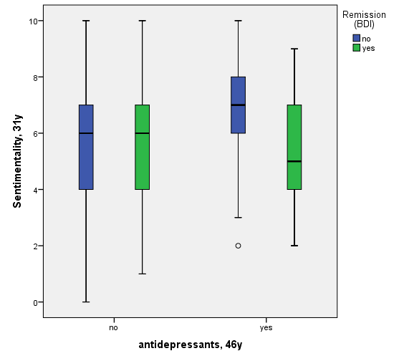
Results
Among those who were not on remission, higher sentimentality (subscale of RD) associated (OR 1.3; 1.1-1.6) with using antidepressant medication at the follow-up.

Slide 9
Discussion
Harm avoidance has been associated also with treatment resistant depression (Takahashi et al. PLoS One 2013) and with treatment response in depression (Kampman et al. Eur Psychiatry 2012)
Sentimentality has been associated previously with depression (Elovainio et al. J Affect Disord 2004), now with treatment adherence.
Effect of temperament on outcome of other disorders?
  Help seeking, adherence, physical activity, substance use, …
Temperament (e.g. harm avoidance) traits associate more strongly with risk of depression than it’s outcome.

Slide 10
- In metabolic diseases? An even in depression?
Boersma et al. Eur J Pharmacology 2011; 667:23-5.

Slide 11

Research team:
Jouko Miettunen^{1,2}, Riikka Marttila^{1,2}, Nina Rautio^{1,2,3}, Eka Roivainen⁴, Sirkka Keinänen-Kiukaanniemi^{1,2,3}, Leena Ala-Mursula¹, Juha Auvinen^{1,3}, Markku Timonen^{1,2}
1 Center for Life Course Health Research, University of Oulu, Oulu, Finland
2 Medical Research Oulu, Oulu University Hospital and University of Oulu, Oulu, Finland
3 Unit of Primary Health Care, Oulu University Hospital, Oulu, Finland
4 Verve Rehabilitation, P.O. Box 404, 90101 Oulu
Acknowledgements:
This study has been supported by the Academy of Finland, the NARSAD: the Brain and Behavior Research Fund, and the Jalmari and Rauha Ahokas Foundation.

